Slide 1
Lecture 2 Introduction to Digital Electronics
Lecture delivered by:
Deepak V.

Slide 2
Objectives
At the end of this lecture, student will be able to:
Describe Digital Signal
Acquire the knowledge of Binary Digits
Outline Positive Logic System
Outline Negative Logic System
Acquire the knowledge of Codes

Slide 3
Topics
Digital Signals
Binary Digits
Positive Logic System
Negative Logic System

Slide 4
Digital Signals
An information variable represented by physical quantity
For digital systems, the variable takes on discrete values
Two level, or binary values are the most prevalent values in digital systems
Binary values are represented abstractly by:
digits 0 and 1
words (symbols) False (F) and True (T)
words (symbols) Low (L) and High (H)
and words On and Off
Binary values are represented by values or ranges of values of physical quantities

Slide 5
Binary Digits
The two digits in the binary system, 1 and 0, are called bits, which is a contraction of the words binary digit

Slide 6
How to represent 0 and 1
In digital circuits, two different voltage levels are used to represent the two bits
The higher/lower voltage level is referred to as a HIGH/LOW, or H/L

Slide 7
Signal Example – Physical Quantity: Voltage
The voltages used to represent a 1 and a 0 are called logic levels
HIGH can be any voltage between a specified minimum value and a specified maximum value
LOW can be any voltage between a specified minimum and a specified maximum

Slide 8
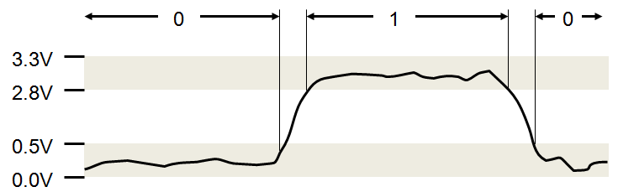
Binary Representations
Figure: Graph representing Binary

Slide 9
Positive Logic System
A 1 is represented by HIGH and a 0 is represented by LOW
Also called ACTIVE HIGH LOGIC

Slide 10
Negative Logic System
A 0 is represented by HIGH and a 1 is represented by LOW
Also called ACTIVE LOW LOGIC

Slide 11
Binary Values: Other Physical Quantities
What are other physical quantities represent 0 and 1
CPU Voltage
Disk
CD Surface Pits/Light
Dynamic RAM Electrical Charge
Magnetic Field Direction

Slide 12
Codes
Groups of bits (combination of 1s and 0s), called codes, are used to represent numbers, letters, symbols, instructions, and anything else required in a given application
The American Standard Code for Information Interchange (ASCII) – pronounced “askee” – is a universally accepted alphanumeric code used in most computers and other electronic equipment

Slide 13
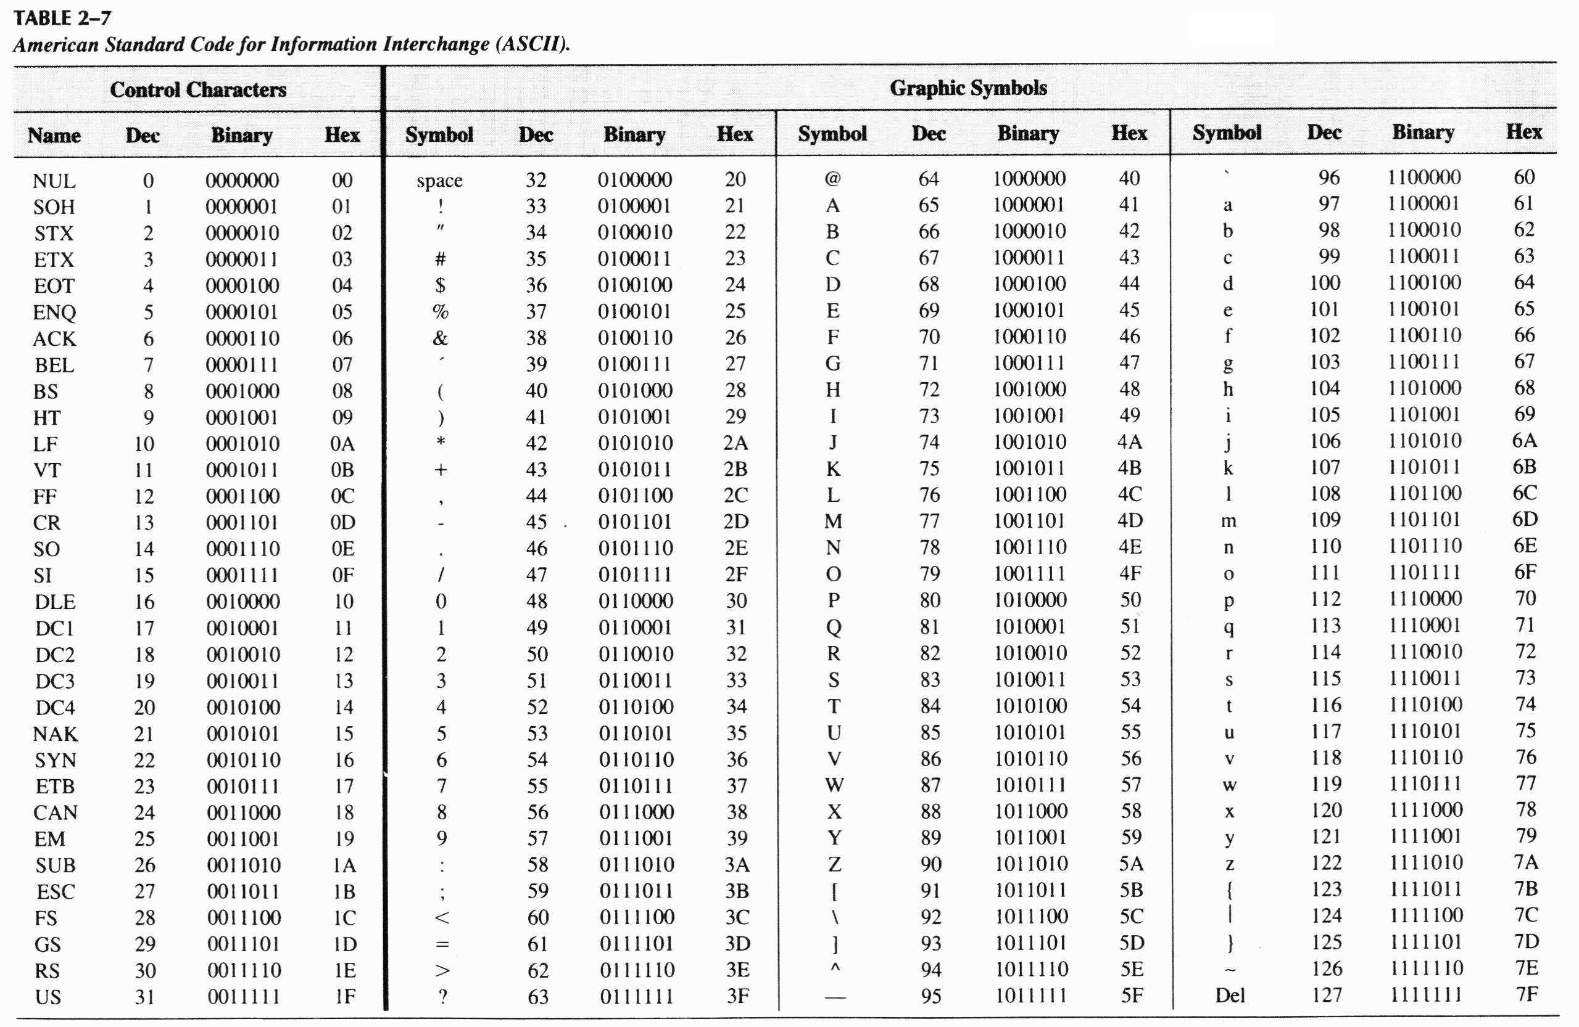
ASCII
Table: ASCII

Slide 14
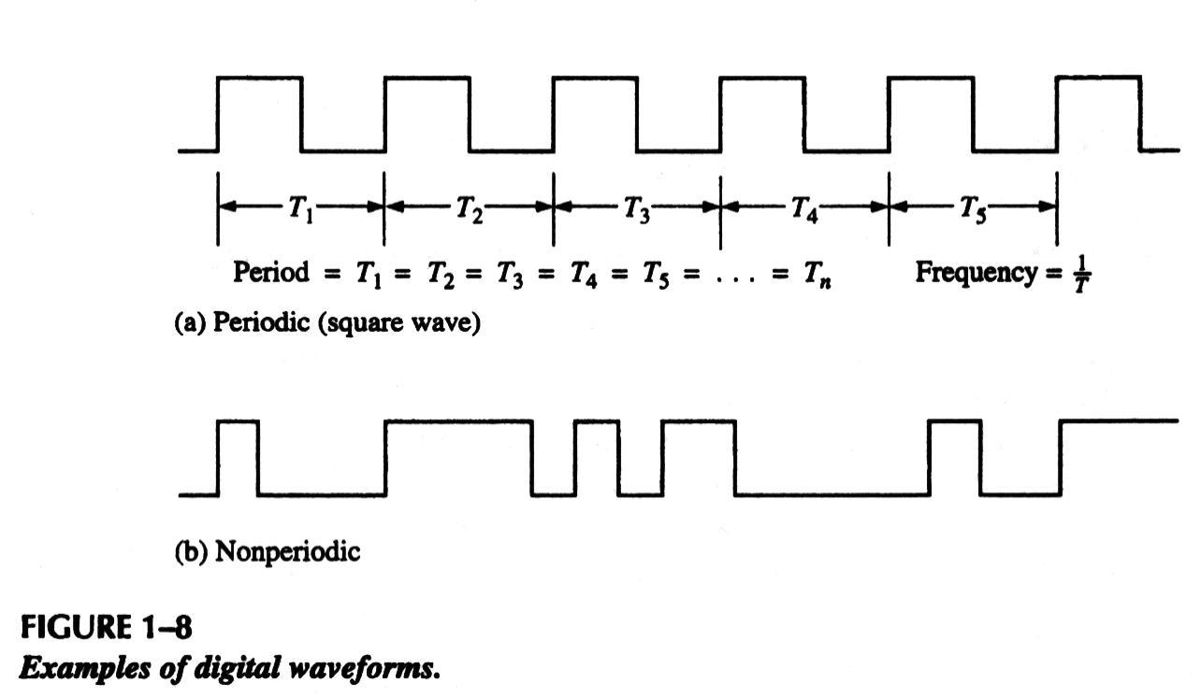
Digital Waveforms
Digital waveforms consists of a series of pulses, (voltage levels that are changing back and forth between the HIGH and LOW levels

Slide 15
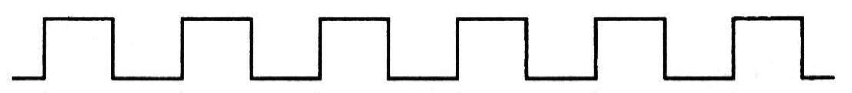
Pulse Train
Digital waveforms are sometimes called pulse trains.
Digital waveforms are sometimes called pulse trains

Slide 16
Summary
For digital systems, the variable takes on discrete values
Two level, or binary values are the most prevalent values in digital systems
The two digits in the binary system, 1 and 0, are called bits, which is a contraction of the words binary digit
Groups of bits (combination of 1s and 0s), called codes, are used to represent numbers, letters, symbols, instructions, and anything else required in a given application.

